Slide 1

The Future of Dentistry
Now in Your Hands
PULPDENT

Slide 2

Changes everything you know about traditional Composites, Glass Ionomers and RMGIs
PULPDENT

Slide 3
Strong, esthetic, bioactive restoratives and base/liner that release and recharge calcium, phosphate and more fluoride than glass ionomers.
PULPDENT

Slide 4
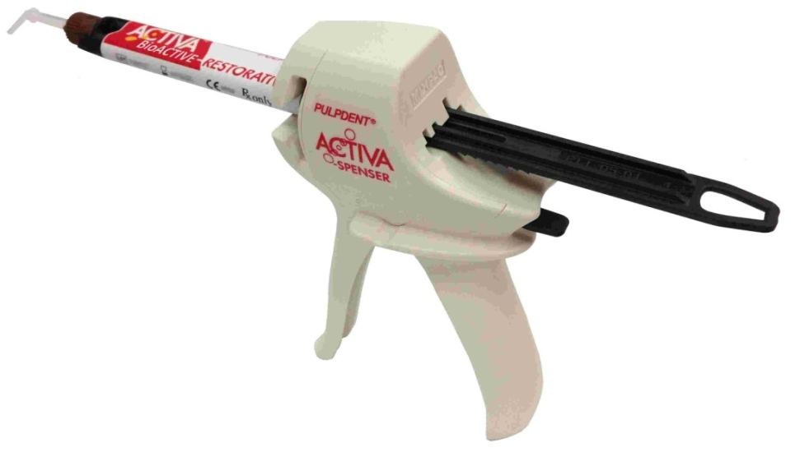
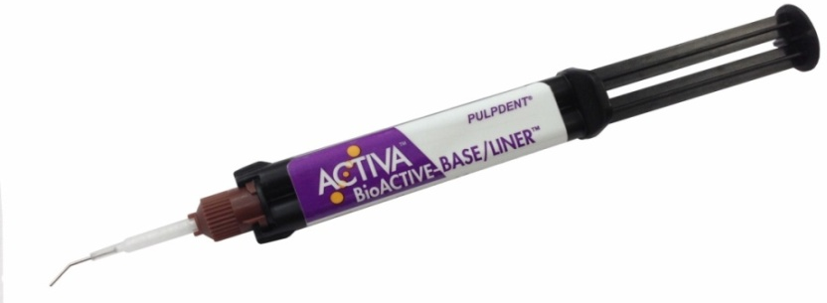
ACTIVA mimics the physical and chemical properties of natural teeth by combining the strength and esthetics of composites with all the benefits of glass ionomers.
BASE/LINER
RESTORATIVE
PULPDENT

Slide 5
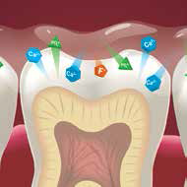
ACTIVA chemically bonds and seals teeth against bacterial leakage, and the continuous diffusion of calcium, phosphate and fluoride ions provides long-term benefits for patients.
PULPDENT

Slide 6
The Ultimate Dental Material - Mimics Natural Teeth
Strong and esthetic like composites
Releases/recharges calcium, phosphate and
more fluoride than glass ionomers
Tough and resilient like dentin and enamel
Chemically bonds - Seals teeth against bacterial leakage
No sensitivity - Biocompatible
Simplified technique - Easy handling and placement
PULPDENT

Slide 7
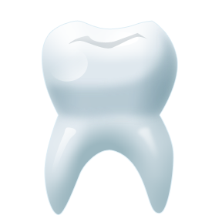
Three key components:
  Patented bioactive ionic resin
  Patented rubberized resin
  Bioactive ionomer glass
PULPDENT

Slide 8
Key Component #1
Bioactive Ionic Resin
  Patented, moisture-tolerant, ionic resin matrix
  Facilitates very high release and recharge of calcium, phosphate and fluoride ions
  Responds to demineralization cycles with release of ions
  Recharge capability provides long-term benefits
  Integrates, penetrates and chemically bonds to teeth
  Seals against bacterial microleakage
PULPDENT

Slide 9
Key Component #2
Rubberized Resin
Patented resin is tough – not brittle
Absorbs stress and shock like dentin
Extremely durable, fracture and wear resistant
Tough and resilient at marginal interface
Does not crumble, wash out, or chip at margins
Mimics physical properties of tooth structure
PULPDENT

Slide 10
Key Component #3
Bioactive Ionomer Glass
Highly bioactive with high fluoride release
Chemically seals and bonds to teeth
Biocompatible – no sensitivity
Moisture friendly
PULPDENT

Slide 11
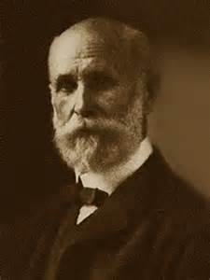
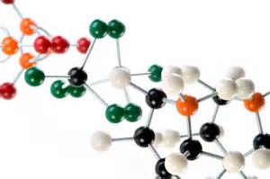
Traditional dental materials are designed to be passive and do no harm. This approach dates back 100 years to the days of G.V. Black.
Bioactive materials are the future. They provide long-term benefits, exhibit “smart behavior,” react to changes in the oral environment, and play a dynamic role in the mouth.
PULPDENT

Slide 12
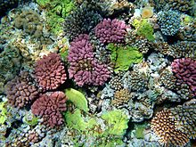
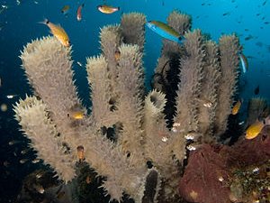
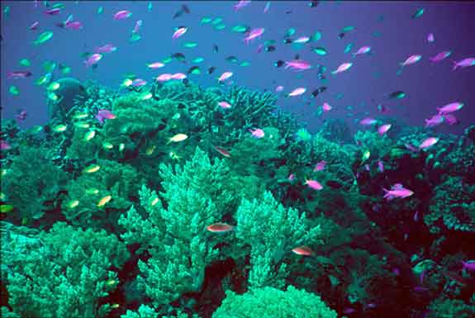
Bioactive dental materials mimic nature. They contain water, interact with saliva and tooth structure, release and uptake calcium, phosphate and fluoride ions, and react to pH changes in the oral environment.
PULPDENT

Slide 13
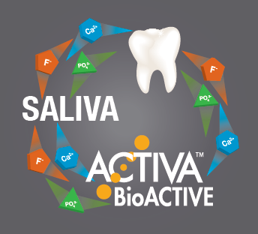
ACTIVA participates with teeth and saliva in a continuous ionic exchange. It responds to the mouth’s natural pH and demineralization cycles with the release and uptake of calcium, phosphate and fluoride ions. This is considered “smart” behavior.
PULPDENT

Slide 14
ACTIVA’s bioactive ionic resin facilitates the diffusion of ions from the resin and glass ionomer, and it recharges with calcium, phosphate and fluoride.
Food ToothpasteWater
Fluoride Ions
Saliva
Ca, F⁺, PO₄ ions
Ca, F⁺, PO₄ ions
Ca, F⁺, PO₄ ions

Slide 15
FDA 510(k) Allows Bioactive Claim
Pulpdent’s 510(k) defines ACTIVA as: “a bioactive resin matrix and bioactive glass fillers. . . ‘bioactive’ refers to the release of beneficial ions from both the resin and glass fillers into the oral environment.”
PULPDENT

Slide 16
Conventional Dental Materials
Composites are strong and esthetic, but are not bioactive and not moisture friendly. They require bonding agents, leak at the margins, are somewhat brittle and can cause sensitivity. Their life expectancy is 5.7 years (NIH statistics)
Glass ionomers are hydrophilic and bioactive, but are brittle and soluble with poor esthetics and poor longevity.
RMGIs are a compromise between composites and GIs. They have bioactive properties but are somewhat brittle and not suitable for esthetic, load-bearing or long-term restorations.
PULPDENT

Slide 17
With traditional materials, as the resin properties increase, bioactivity decreases. ACTIVA combines the best attributes of composite resins and glass ionomers plus a patented rubberized resin for unsurpassed toughness and fracture resistance.
Bioactive, Esthetic, Durable, Not Brittle
ACTIVA
Glass Ionomers:
Composites:
Bioactive
Poor esthetics
Not durable
Brittle
Wash out
Not bioactive
Great esthetics
Durable but Brittle
Last 5.7 years (NIH)
Cause Sensitivity
Glass ionomer
Composite
RMGI
PULPDENT

Slide 18
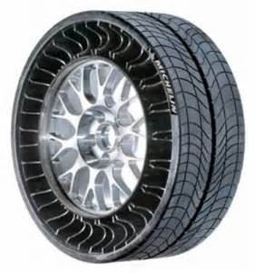
Tough Rubberized Resin
ACTIVA’s rubberized resin provides unparalleled toughness. Toughness, measured by Deflection at Break, is the ability of a strong, hard material to absorb stress, dissipate forces and resist fracture.
Automobile tires are really tough.

Slide 19
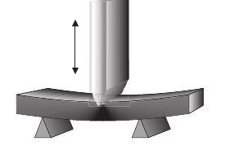
Tough vs. Brittle: Deflection at Break
To measure toughness, strong hard materials are subjected to a 3-point bend test. Their toughness is determined by how far they can flex before fracturing.
PULPDENT

Slide 20
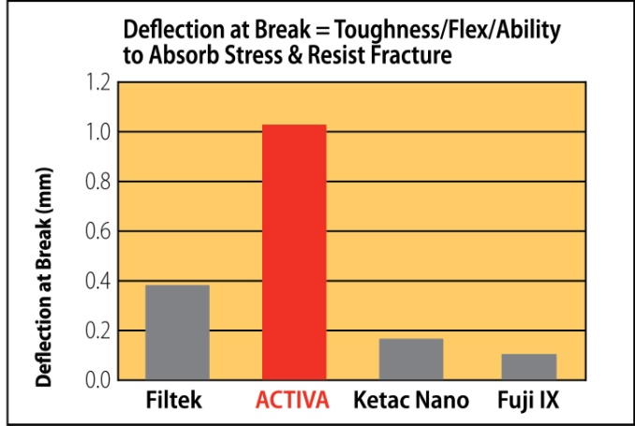
Deflection at Break of ACTIVA is 2-3 times greater than composites and 5-10 times greater than GIs and RMGIs
Toughness – Deflection at Break
Deflection at Break (Flex data) of Restorative Materials
Deflection at break of restorative materials. Chao W, et al. J Dent Res 94 (Spec Iss A) 2375, 2015 (www.iadr.org).
PULPDENT

Slide 21
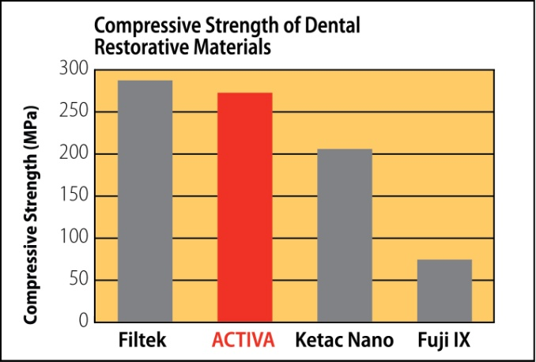
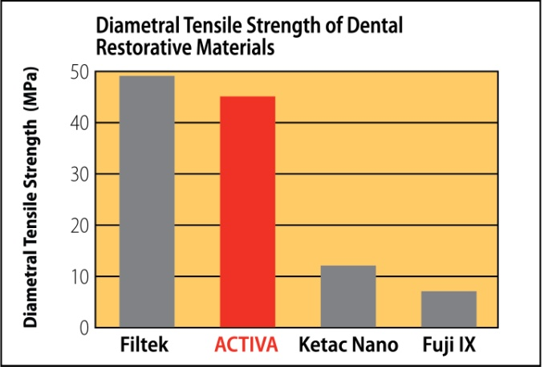
Compressive and Diametral Tensile Strength of ACTIVA BioACTIVE-RESTORATIVE is comparable to composites and greater than RMGI and GIs.
Strength
ACTIVA = BioACTIVE Restorative; Filtek = Composite; Ketak Nano = RMGI; Fuji IX = GI
Comparison of Mechanical Properties of Dental Restorative Material. Girn V, et al. J Dent Res 93 (Spec Iss A) 1163, 2014 (www.iadr.org).
PULPDENT

Slide 22
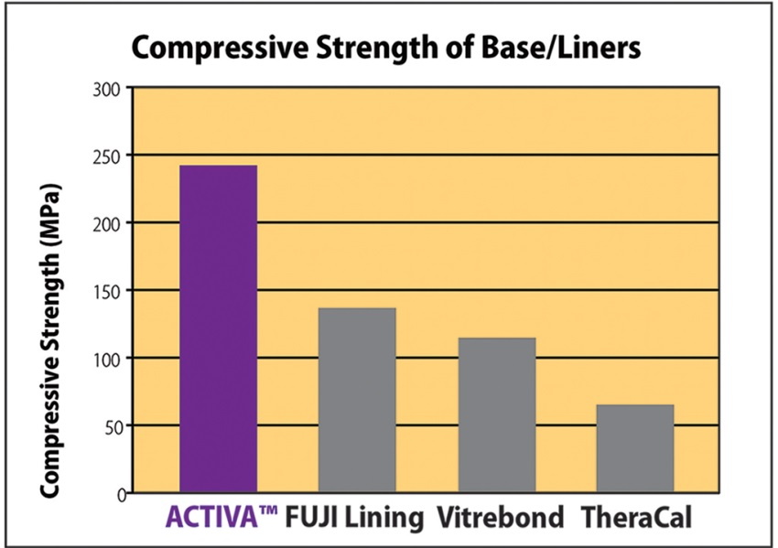
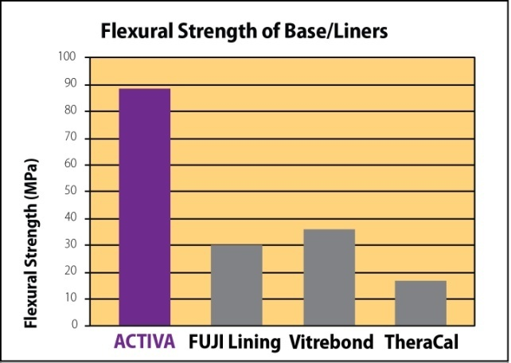
Compressive and Flexural Strength of ACTIVA BioACTIVE-BASE/LINER is much greater than RMGIs.
Strength
ACTIVA = BioACTIVE Base/Liner; Fuji Lining & Vitrebond = RMGI;
TheraCal = Resin-Modified Calcium Silicate
PULPDENT

Slide 23
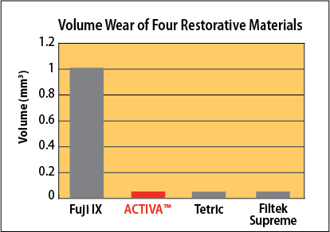
Wear of a Calcium, Phosphate and Fluoride Releasing
Restorative Material
Bansal R. J Dent Res 94 (Spec Iss A) 3797, 2015 (www.iadr.org)
Wear
Volume wear of ACTIVA BioACTIVE-RESTORATIVE is comparable to composites and far less than glass ionomer.
PULPDENT

Slide 24
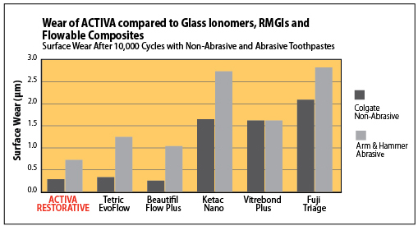
Wear resistance of new ACTIVA compared to other restorative materials.
Garcia-Godoy F, Morrow BR. J Dent Res 94 (Spec Iss A) 3522, 2015 (www.iadr.org)
Wear
When evaluated for surface wear resistance, ACTIVA BioACTIVE-RESTORATIVE performed better than all other materials tested with abrasive toothpaste and was comparable to flowable composites with non-abrasive toothpaste.
PULPDENT

Slide 25
Relatively low water absorption is advantageous for bioactive materials, which require water to unlock their bioactive potential. ACTIVA has slightly more water absorption than composites, which are hydrophobic and not bioactive, and far less than glass ionomers and RMGIs.
Water Absorption
ACTIVA = BioACTIVE Restorative; Filtek = Composite; Ketac Nano & Fuji ll LC = RMGI; Fuji IX = GI
PULPDENT

Slide 26
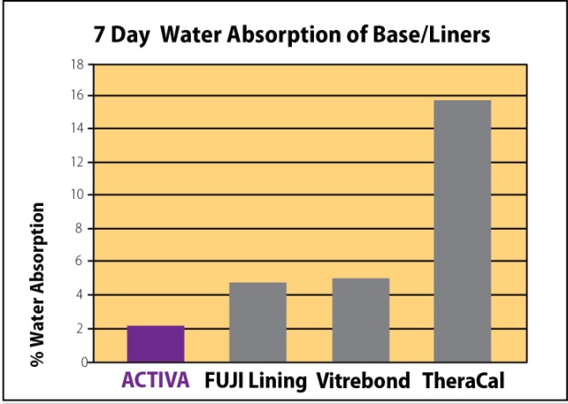
Excessive water absorption compromises materials. Water absorption of ACTIVA BioACTIVE-BASE/LINER is far less than RMGIs. Water absorption of TheraCal is 7 times greater than ACTIVA.
Water Absorption
ACTIVA = BioACTIVE Base/Liner; Fuji Lining & Vitrebond = RMGI;
TheraCal = Resin-Modified Calcium Silicate
PULPDENT

Slide 27
Low water solubility is important for durability and longevity. Solubility of ACTIVA is comparable to composites and far lower than glass ionomers and RMGIs.
Solubility
ACTIVA = BioACTIVE Restorative; Filtek = Composite; Ketac Nano & Fuji ll LC = RMGI; Fuji IX = GI
PULPDENT

Slide 28
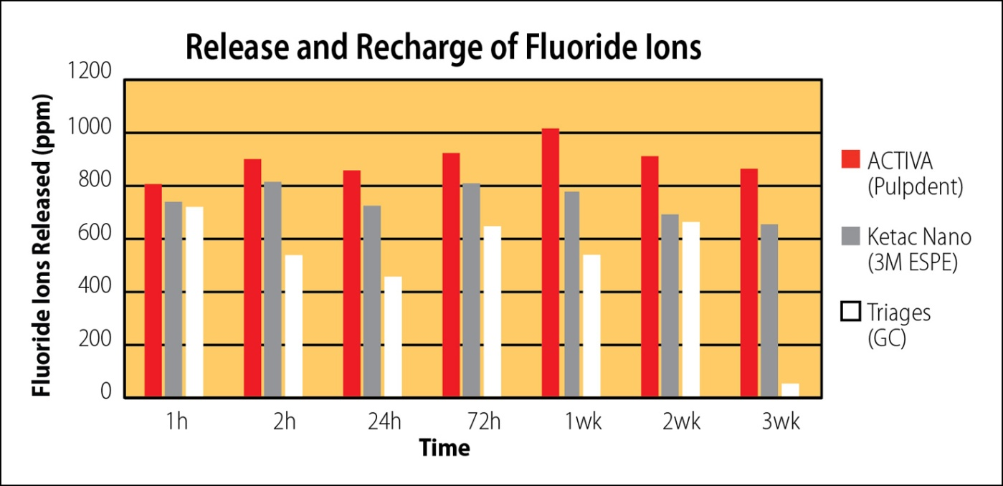
Fluoride Release and Recharge
ACTIVA releases and recharges fluoride, providing long-term benefits of fluoride.
Conclusions: “This study demonstrates that the new bioactive material [ACTIVA] has potentially greater fluoride diffusion and release after 72 hours.”
Slowokowski L, et al. J Dent Res 93 (Spec Iss A) 268, 2014 (www.iadr.org).
PULPDENT

Slide 29
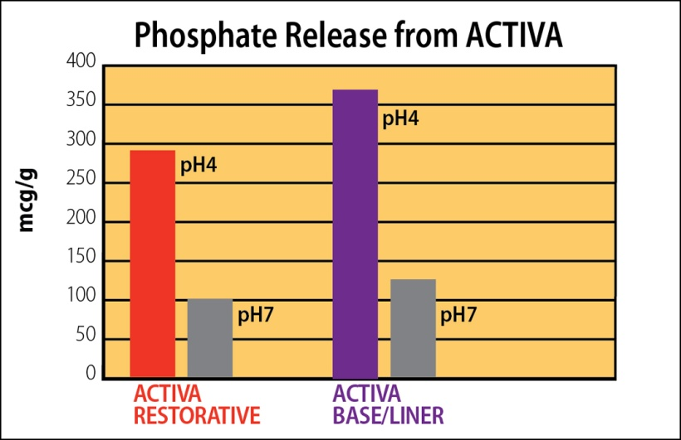
Phosphate Release
ACTIVA is a “smart” material that responds to pH cycles in the mouth. During low pH demineralization cycles, ACTIVA releases more phosphate, which is available to interact with calcium and fluoride ions during higher pH cycles.
PULPDENT

Slide 30
  ACTIVA BioACTIVE contains NO Bisphenol A,
  NO Bis-GMA and NO BPA derivatives.
ACTIVA is triple cure:
  Light cure
  Self-cure resin chemistry
  Self-cure glass ionomer acid-base reaction
ACTIVA products are 2-paste products
  packaged in 5mL automix syringes.
  Use the ACTIVA-Spenser to easily dispense the RESTORATIVE material.
  Mix tips with unique bendable metal cannula provide precise placement.
PULPDENT

Slide 31

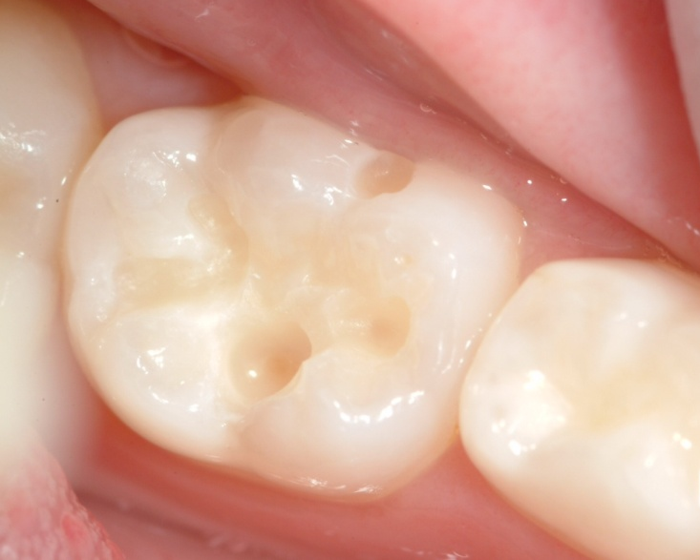
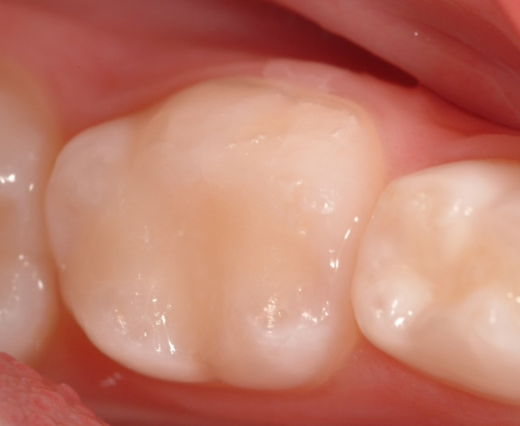
ACTIVA BioACTIVE-RESTORATIVE is a dentin and enamel replacement material with the strength and esthetics of composites, but with greater toughness and fracture resistance.
Shows conservative cavity prep.
Shows tooth restored with
ACTIVA BioACTIVE-RESTORATIVE
Available in A1, A2, A3, A3.5.
PULPDENT

Slide 32
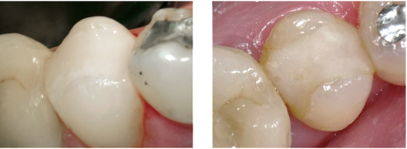
ACTIVA BioACTIVE-RESTORATIVE 30-month recall shows excellent esthetics, no wear or chipping, and no marginal staining.
October 7, 2012
Immediate post-op
March 23, 2015
30-month recall photo
PULPDENT

Slide 33
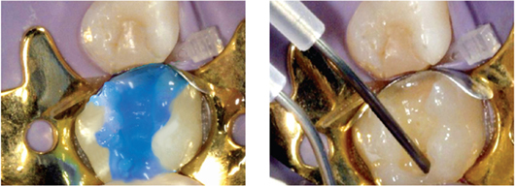
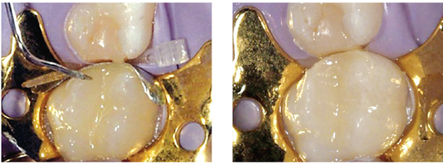
ACTIVA BioACTIVE-RESTORATIVE is used to replace a failed composite restoration.
Etch 10 seconds, rinse and remove all surface moisture . Do not desiccate the tooth.
ACTIVA is placed using bendable metal cannula.
Explorer is used to create anatomy.
Shows finished and polished restoration.
PULPDENT

Slide 34
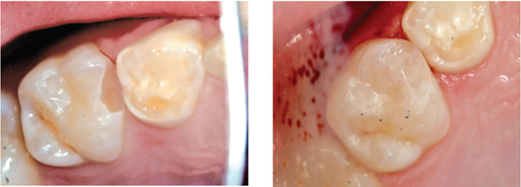
ACTIVA BioACTIVE-RESTORATIVE used for a minimally invasive Class ll restoration
Shows minimally invasive tooth preparation.
After 10-second etch and removal of all surface moisture, shows esthetic ACTIVA restoration.
PULPDENT

Slide 35
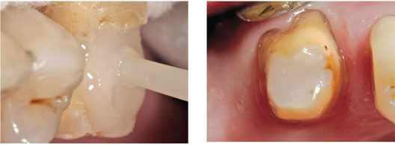
ACTIVA BioACTIVE-RESTORATIVE used as a core build up material
ACTIVA is used to build up the core on a badly broken down molar.
The tooth is ready to receive a crown.
PULPDENT

Slide 36
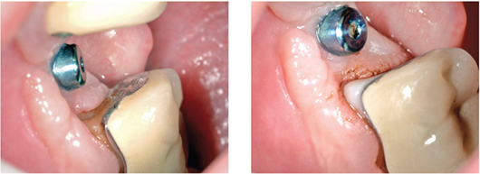
ACTIVA BioACTIVE-RESTORATIVE used for repairing caries under a crown margin
Caries under crown margin has been removed. Tooth will be etched, rinsed and all moisture removed from the tooth surface.
ACTIVA bonds to tooth, metal and ceramics and mimics the function of missing tooth structure.
PULPDENT

Slide 37
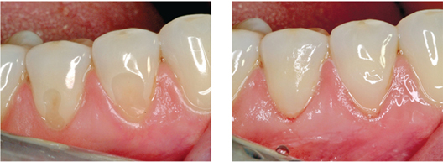
ACTIVA BioACTIVE-RESTORATIVE used to repair sensitive cervical lesions
Shows cervical lesions of lower bicuspids.
After etching, bonding agent was applied for added retention. ACTIVA provides, esthetics, bioactivity and patient comfort.
PULPDENT

Slide 38

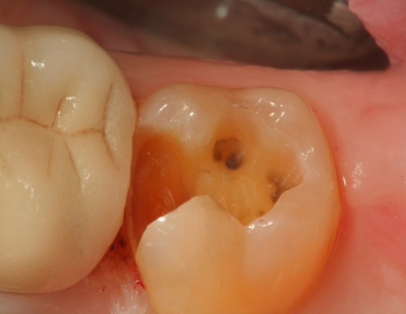
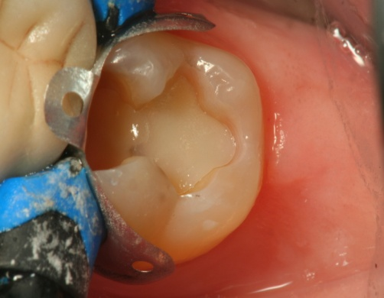
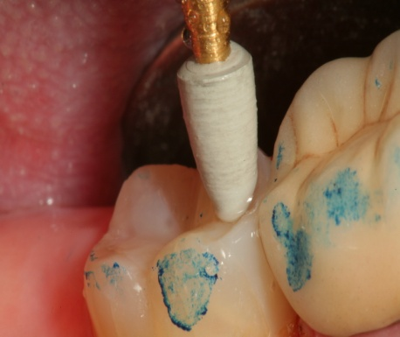
ACTIVA BioACTIVE-BASE/LINER replaces RMGIs, glass ionomers, and flowable composites. No etching, no bonding agents, no crumbling, no sensitivity.
Shows prepared tooth.
Shows ACTIVA BioACTIVE-BASE/LINER after light curing. Dentin shade is approx A2.5.
Finish restoration using composite or ACTIVA BioACTIVE-RESTORATIVE.
PULPDENT

Slide 39
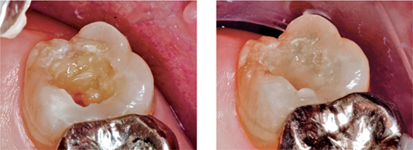
ACTIVA BioACTIVE-BASE/LINER penetrates and integrates with tooth structure. It seems to become part of the tooth.
Shows prepared tooth after removing deep caries under a failed composite restoration.
Shows ACTIVA BioACTIVE-BASE/LINER after curing. No etching required. Note dentin shade match.
PULPDENT

Slide 40
ACTIVA™ BioACTIVE PRODUCTS
ACTIVA™ BioACTIVE-BASE/LINER™
VB1 SINGLE PACK: 5mL/7gm syringe + 20 mix tips w/ metal cannula
VB2 VALUE PACK: 2 x 5mL/7gm syringes + 40 mix tips w/ metal cannula
ACTIVA™ BioACTIVE-RESTORATIVE™
VR* STARTER KIT: 5mL/8gm syringe, ACTIVA-SPENSER
+ 20 assorted mix tips (10 w/ metal cannula + 10 w/ IOT)
Starter Kit available in A1, A2 and A3 shade only
VR1* SINGLE REFILL: 5mL/8gm syringe, + 20 assorted mix tips
(10 w/ metal cannula + 10 w/ IOT)
VR2* VALUE PACK: 2 x 5mL/8gm syringe + 40 assorted mix tips
(20 w/ metal cannula + 20 w/ IOT) *Specify Shade: A1, A2, A3, A35 (for A3.5)
ACTIVA-SPENSER™
DS05 Dispenser for 5mL 1:1 automix syringes
PULPDENT

Slide 41
Mix Tips for ACTIVA™ PRODUCTS
For use with 2.5mL, 5mL and 10mL 1:1 automix syringes
TIPS – APPLICATOR
A20N1 Automix tips, clear, w/ bendable 20-gauge metal cannula – pkg of 20
A50N1 Automix tips, clear, w/ bendable 20-gauge metal cannula – pkg of 50
Supplied with ACTIVA BioACTIVE-BASE/LINER and RESTORATIVE
For use with 2.5mL, 5mL and 10mL 1:1 automix syringes
AD20T Automix Tips, clear, + short intra oral tips (IOT) - pkg of 20
AD50T Automix Tips, clear, + short intra-oral tips (IOT) – pkg of 50
Supplied with ACTIVA BioACTIVE-RESTORATIVE
For use with 2.5mL, 5mL and 10mL 1:1 automix syringes
AD20R Automix Tips, clear, + long, narrow intra oral tips (IOR) – pkg of 20
AD50R Automix Tips, clear, + long, narrow intra oral tips (IOR) – pkg of 50
For use with 2.5mL, 5mL and 10mL 1:1 automix syringes
AS20 Automix Tips, clear, straight, tapered – pkg of 20
AS50 Automix Tips, clear, straight, tapered – pkg of 50
For use with 2.5mL, 5mL and 10mL 1:1 automix syringes
PULPDENT

Slide 42



The Future of Dentistry
Now in Your Hands
PULPDENT

